Slide 1


App instructions
How to get started using our new (and first) app!

Slide 2
Downloading the App
1. Find and open the App Store on an iPhone
(or the Google Play Store if you use an Android phone).
2. At the top of the screen, tap the search box and type
Lonesome Pine Regional Library.
3. When you see the library app, tap Download or Install.
4. Open the app to proceed to login.
*After downloading, the app may ask about location access.
  Please select “Allow” or “Only when using the app.”
  This helps the app show the libraries closest to you.*

Slide 3
Signing In
1. Look for the menu button (three lines ☰) near the top corner and tap it.
2. Tap Sign In and select continue or the scan barcode button
You will be asked for your library card number:
  You can type the numbers from the back of your library card, or
  Use the camera option to scan the barcode on the card.
3. When asked for a PIN, enter the last four digits of your library card number.

Slide 4
Turning On Notifications (reminders and library updates.)
1. Look for the menu button (three lines ☰) near the top corner and tap it.
2. Tap Preferences.
3. Turn on Library News.

Slide 5
Double checking that notifications are on (Very Important)
1. Open your phone’s Settings.
2. Tap Notifications.
3. Find the library app in the list and be sure notifications are turned ON.
4. This allows the library to send helpful reminders, news, and updates to your phone.

Slide 6


Using the App Features
What does it do?

Slide 7
My Account
Under My Account, you can see:
  Books you have checked out
  Items on hold
  Any fines or fees
Tap the Fox icon to view your account details.
Tap any of the words like “holds, fines
ect,” again for more information.

Slide 8
Downloadable Books & Magazines
There is a section called Downloadables.
This takes you to:
  eBooks
  Audiobooks
  Magazines
  And more
These items can be enjoyed right on your device.

Slide 9
Barcode Scanner
The ISBN Barcode Scanner lets you scan:
  Books
  DVDs
  Video games
  Tonies
You can scan items at:
  A grocery store
  A friend’s house
  School
  Anywhere
The app will tell you if the library has that item.
This can save money and help you find materials easily.

Slide 10
Notifications Help Menu
There is a menu with instructions on turning on notifications.
This includes alerts for:
  Holds
  Due dates
  Library closures
  Events and programs

Slide 11
Databases
This section links to the library’s website.
To find them:
  Tap the globe icon
  Then tap Databases
Databases offer helpful research and information resources.

Slide 12
Nearest Libraries
This shows libraries closest to you.
Location access must be turned on.
Tap a library to see:
  Hours
  Phone number
  Directions on a map
  Website information

Slide 13
Events Calendar
The Events Calendar shows upcoming programs.
You may:
  Select a specific branch, or
  Scroll down to see events for the regional office

Slide 14
Social Medias
Bottom of the app page has links to the libraries Facebook and Instagram.

Slide 15
Wrap-up
-Questions?
-Comments?
-Concerns?

Slide 16
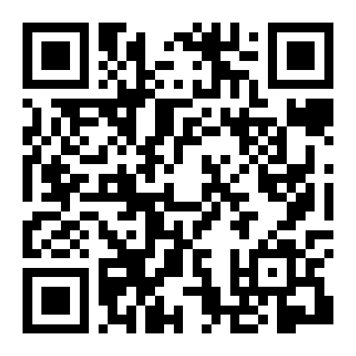
Thank you!!!! Please
Tell your friends, family, co-workers, and others in your community!

